Slide 1
Data Mining: Advanced Techniques Graph Mining
主讲教师: 陈佳伟, sleepyhunt@zju.edu.cn
https://jiawei-chen.github.io/
TA: 陈德仿, defchern@zju.edu.cn
Slides from Sheng Zhou https://zhoushengisnoob.github.io/courses/index.html?course=gnn-2022

Slide 2
Why graph mining?
A graph is a mathematical structure used to model pairwise relations between objects.
Graph is ubiquitous in our world, e.g., social networks, molecular graph, transactions, Internet of Things (IoT), etc.
Mining on graph can utilize both features and relations of individuals
Graph+ML has been widely applied in many fields
Notes:
机器学习是基础。

Slide 3
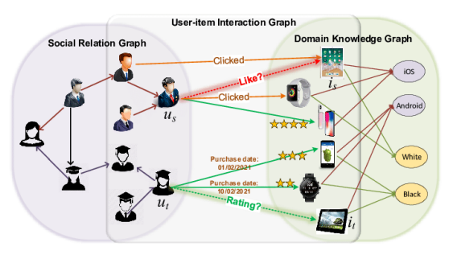
Why graph mining?
Recommender system
Slide from Sheng Zhou
Notes:
机器学习是基础。

Slide 4
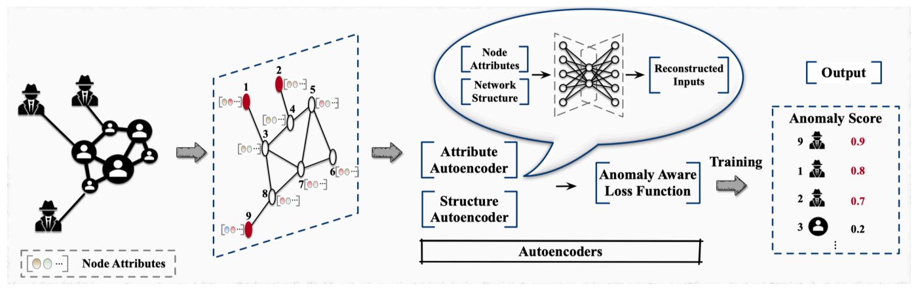
Why graph mining?
Anomaly detection
Slide from Sheng Zhou
Notes:
机器学习是基础。

Slide 5
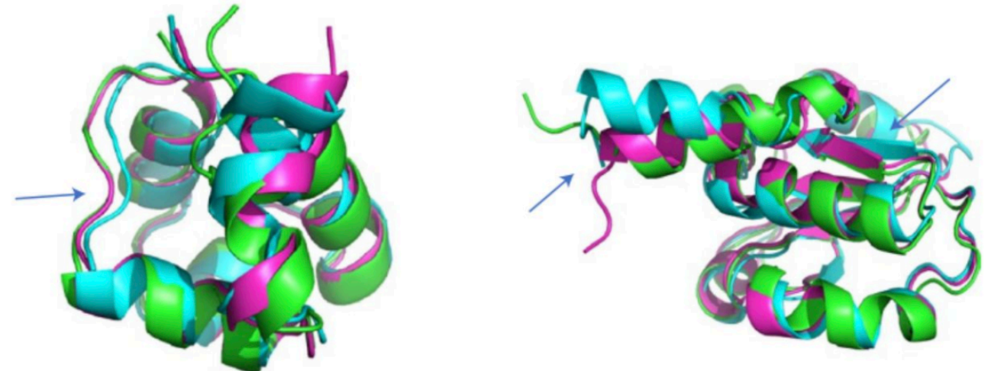
Why graph mining?
Protein structure prediction
Slide from Sheng Zhou
Notes:
机器学习是基础。

Slide 6
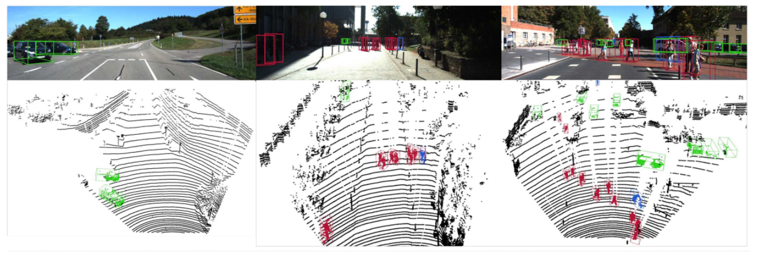
Why graph mining?
Computer vision
Slide from Sheng Zhou
Notes:
机器学习是基础。

Slide 7
Graph Mining
Graph data
Classic graph representation learning
Graph neural network
Promising directions
7
Notes:
7

Slide 8
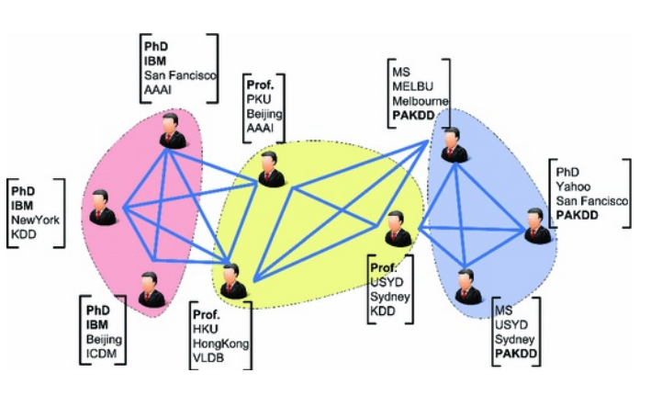
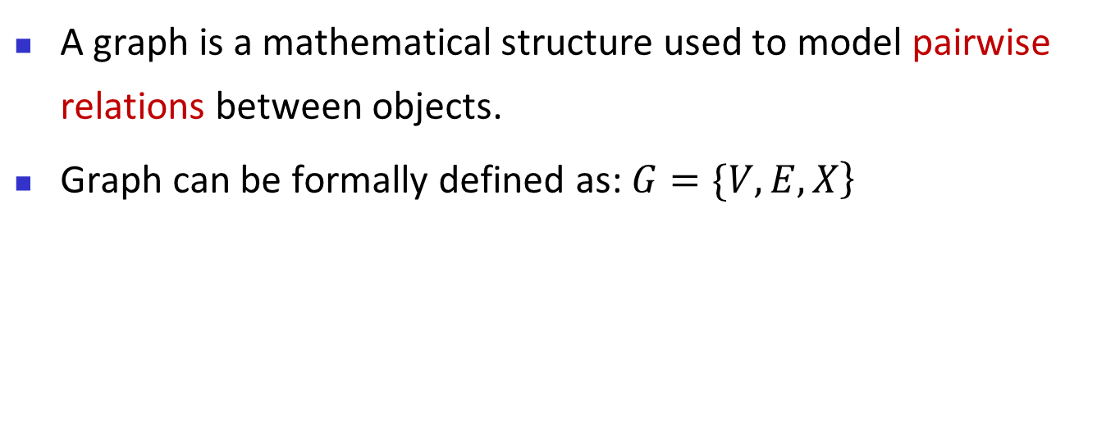
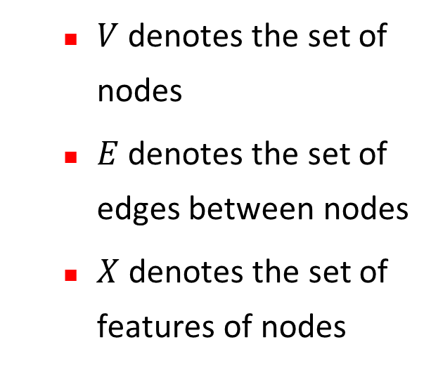
What is graph?
A graph is a mathematical structure used to model pairwise relations between objects.
Graph can be formally defined as: $\left.G=\{V,E,X\right\}$
$V$ denotes the set of nodes
$E$ denotes the set of edges between nodes
$X$ denotes the set of features of nodes
Notes:
机器学习是基础。

Slide 9
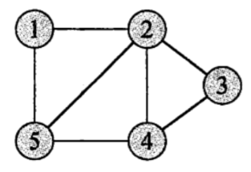
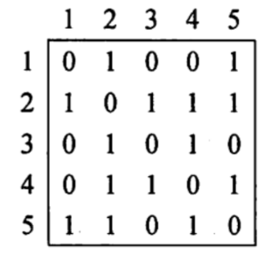
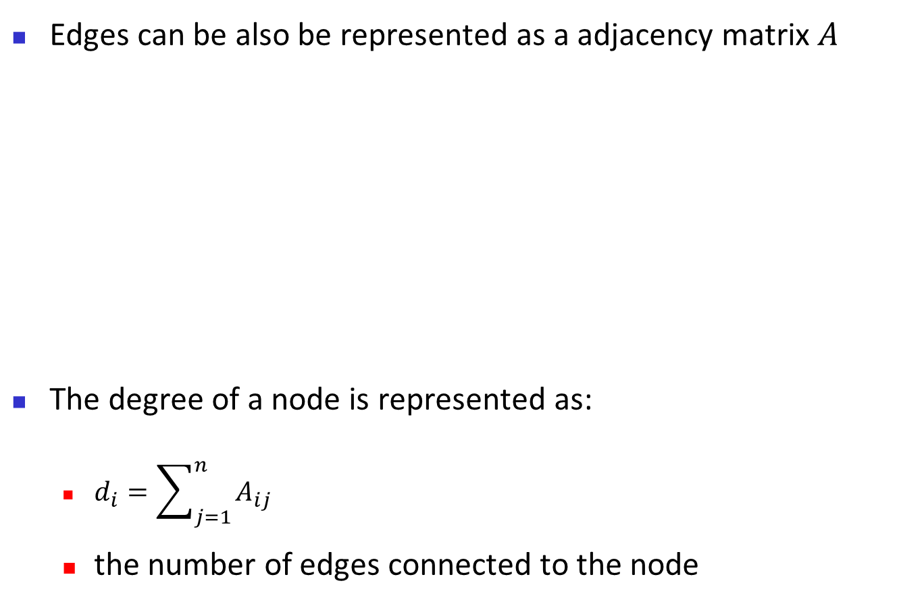
What is graph?
Edges can be also be represented as a adjacency matrix $A$
The degree of a node is represented as:
$d_{i}=\sum_{j=1}^{n}{A_{ij}}$
the number of edges connected to the node
Notes:
机器学习是基础。

Slide 10
What is graph?
Complex graph
Directed Graph
Weighted Graph
Heterogeneous Graph
Multiplex Graph
Dynamic Graph
…….
Slide from Sheng Zhou
Notes:
机器学习是基础。

Slide 11
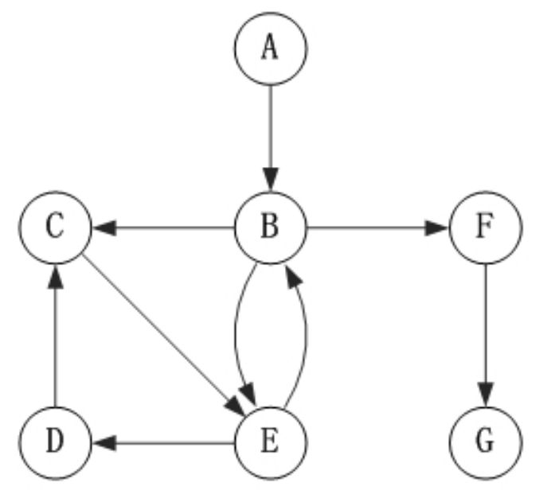
What is graph?
Directed Graph
Asymmetric relations
A-> B does not suggest B-> A
Applications
Transaction
Follow in social network
Citation
Slide from Sheng Zhou
Notes:
机器学习是基础。

Slide 12
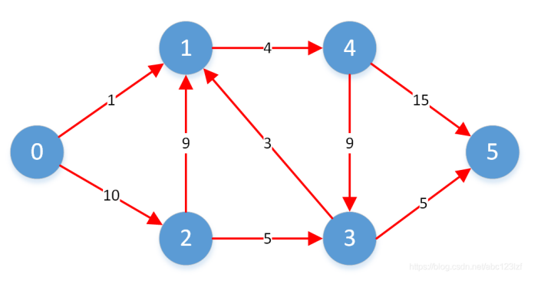
What is graph?
Weighted Graph
Each edge is companied with a weight
The relationships are not equivalent
Applications
Friendship
Transaction
Traffic flow
Slide from Sheng Zhou
Notes:
机器学习是基础。

Slide 13
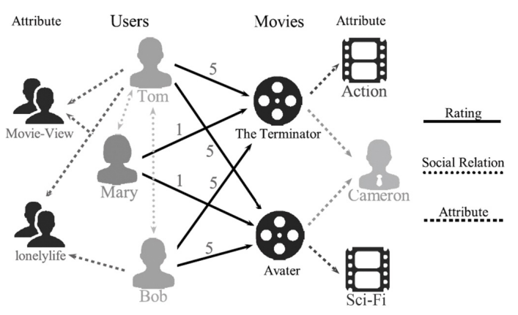
What is graph?
Heterogeneous Graph
Multiply types of nodes/edges
Diverse features of nodes/edges
Applications
Knowledge graph
Social network
Citation network
Slide from Sheng Zhou
Notes:
机器学习是基础。

Slide 14
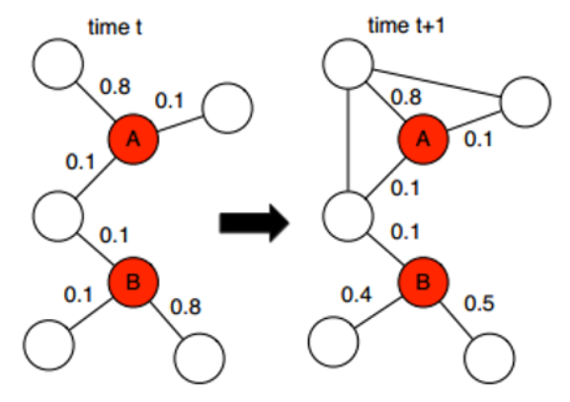
What is graph?
Dynamic (Temporal) Graph
Graph structure or features evolves with time
Applications
Social network
Citation network
Transportation network
Slide from Sheng Zhou
Notes:
机器学习是基础。

Slide 15
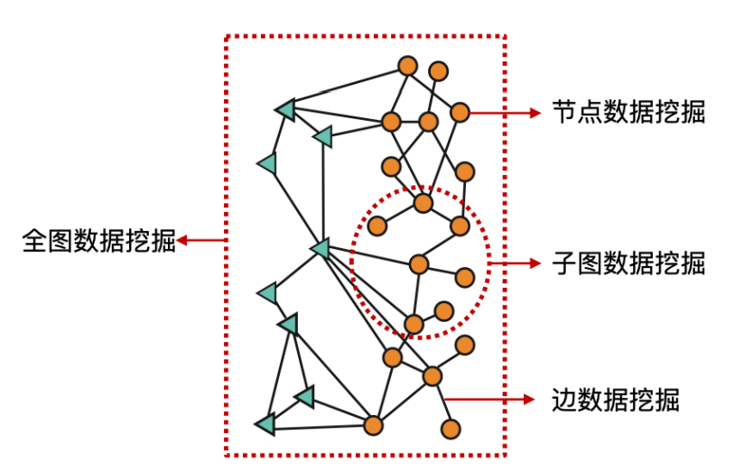
Graph mining
Task of graph mining
Slide from Sheng Zhou
Notes:
机器学习是基础。

Slide 16
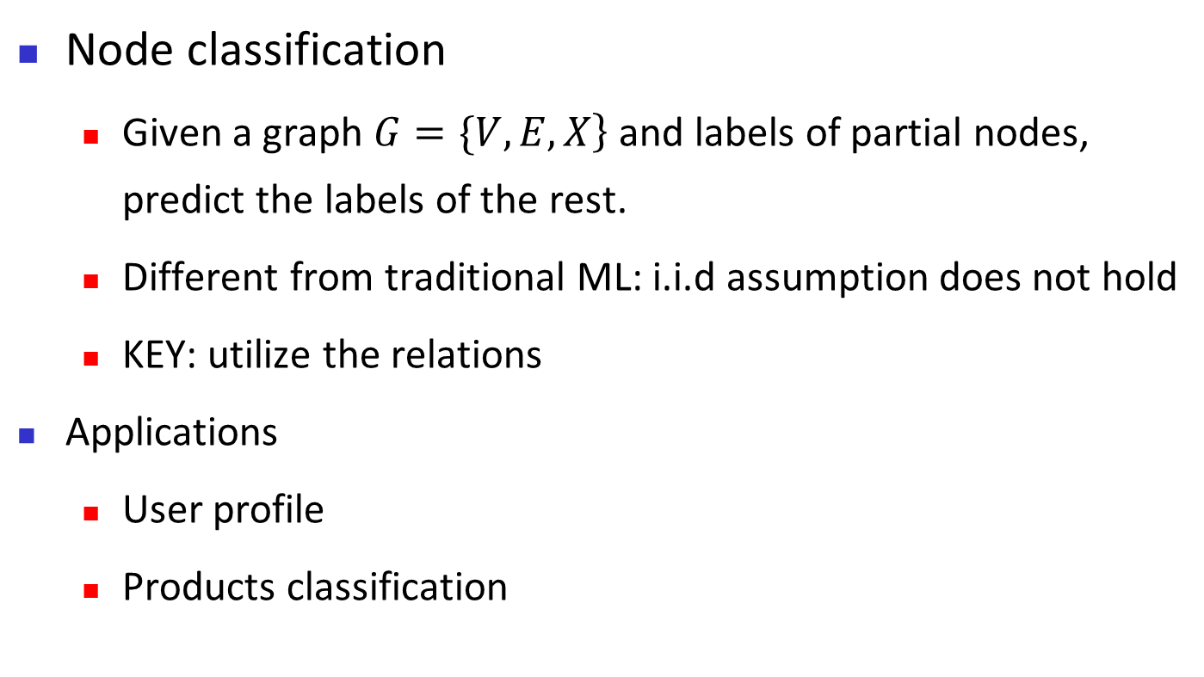
Graph mining
Node classification
Given a graph $\left.G=\{V,E,X\right\}$and labels of partial nodes, predict the labels of the rest.
Different from traditional ML: i.i.d assumption does not hold
KEY: utilize the relations
Applications
User profile
Products classification
Slide from Sheng Zhou
Notes:
机器学习是基础。

Slide 17
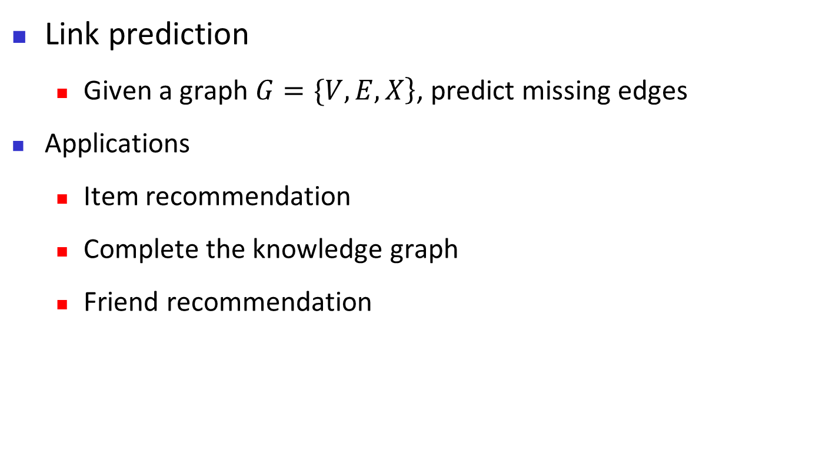
Graph mining
Link prediction
Given a graph $\left.G=\{V,E,X\right\}$, predict missing edges
Applications
Item recommendation
Complete the knowledge graph
Friend recommendation
Slide from Sheng Zhou
Notes:
机器学习是基础。

Slide 18
Graph mining
Important motif mining
a motif is a small, recurring, and statistically significant subgraph within a graph
the process of identifying important motif for understanding the properties and functions of graphs
Applications
Graph interpretability
molecule
Notes:
机器学习是基础。

Slide 19
Graph mining
Graph classification
assigning a label to an entire graph based on its structure, properties, or attributes.
Applications
Drug discovery
Fraud detection
Protein function prediction
Notes:
机器学习是基础。

Slide 20
Graph Mining
Graph data
Classic graph representation learning
Graph neural network
Promising directions
20
Notes:
20

Slide 21
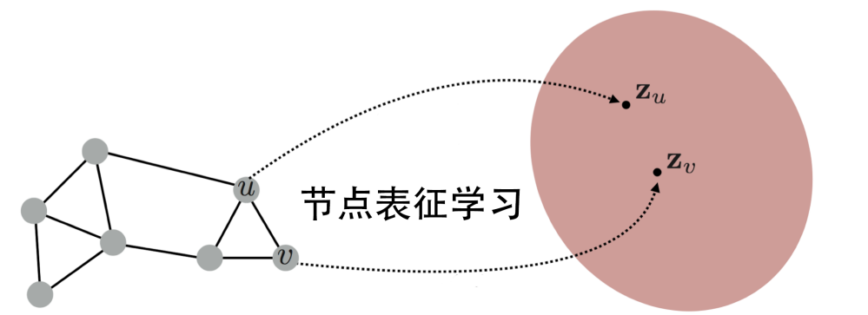
Graph Representation Learning
Representation learning
map each node/graph into continuous low-dimensional vectors space
preserve structural and relational information of the graph
Slide from Sheng Zhou
Notes:
机器学习是基础。

Slide 22
Graph Representation Learning
Motivation
Original graph is hard to be utilized
Sparsity of the adjacent matrix
Diverse information
Relations between nodes
Benefits of embedding
Uniform representation
Low-dimension benefit memorization
Compatible to ML
Slide from Sheng Zhou
Notes:
机器学习是基础。

Slide 23
Graph Representation Learning
Classic graph representation learning
Matrix factorization
Random walk
Slide from Sheng Zhou
Notes:
机器学习是基础。

Slide 24
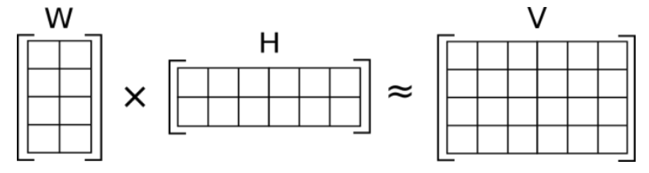
Graph Representation Learning
Matrix factorization
factorizing a matrix into a product of two lower-dimensional matrices
The goal is to approximate the original matrix by capturing its underlying structure and patterns
W, H: embedding
of nodes
V: graph features
Slide from Sheng Zhou
Notes:
机器学习是基础。

Slide 25
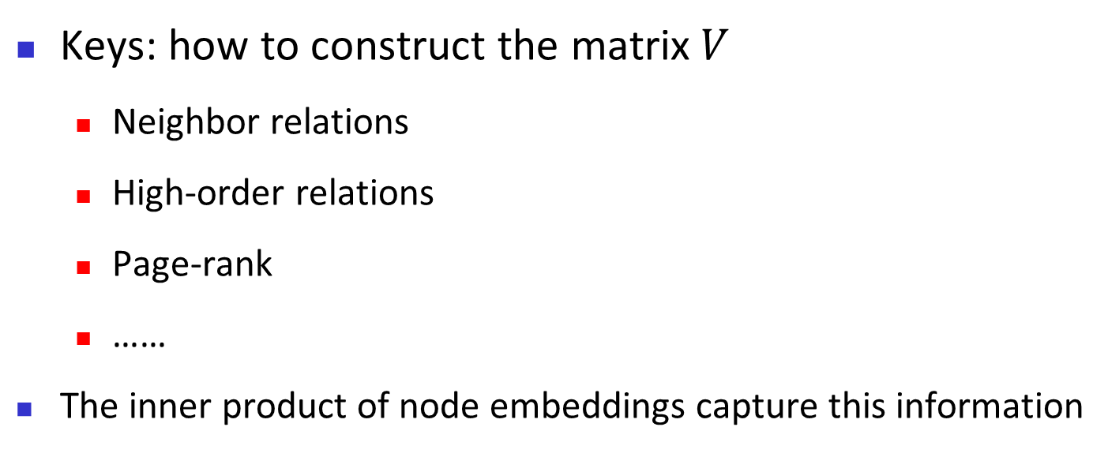
Matrix factorization
Keys: how to construct the matrix$V$
Neighbor relations
High-order relations
Page-rank
……
The inner product of node embeddings capture this information
Slide from Sheng Zhou
Notes:
机器学习是基础。

Slide 26
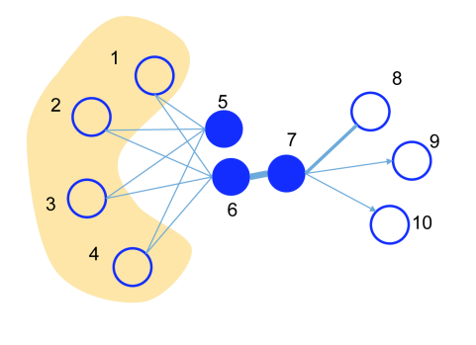
Matrix factorization
Neighbor relations
First-order Proximity: whether the two nodes are connected
Second-order Proximity: Proximity of the neighbors of two nodes
WWW’15: LINE: Large-scale Information Network Embedding.
Notes:
机器学习是基础。

Slide 27
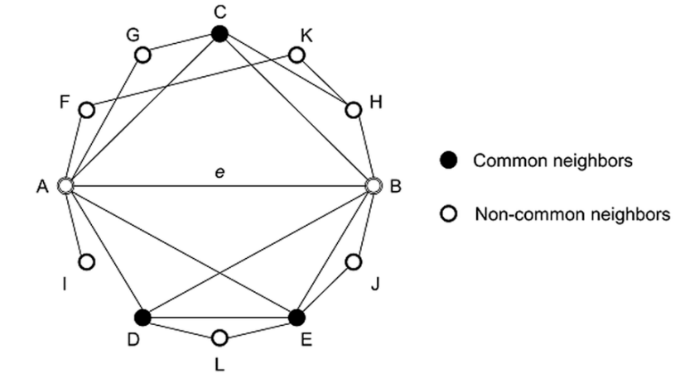
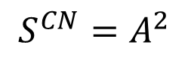
Matrix factorization
High-order neighbor relations
Common Neighbors: the number of common neighbors between two nodes
$$S^{CN}=A^{2}$$
Slide from Sheng Zhou
Notes:
机器学习是基础。

Slide 28
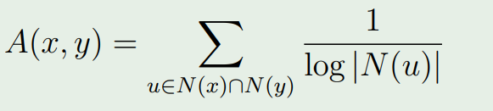
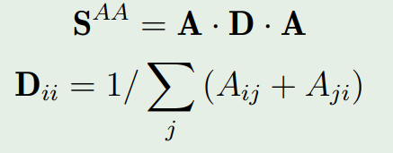
Matrix factorization
High-order neighbor relations
Adamic-Adar: integrate degrees into common neighbors
Matrix form:
Slide from Sheng Zhou

Slide 29
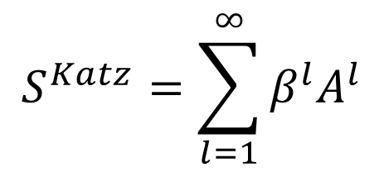
Matrix factorization
High-order neighbor relations
Katz distance takes into account the total number of paths between two nodes in a network
The importance of each path is weighted according to the length of the path
$$S^{Katz}=\sum_{l=1}^{∞}{β^{l}A^{l}}$$
Slide from Sheng Zhou

Slide 30
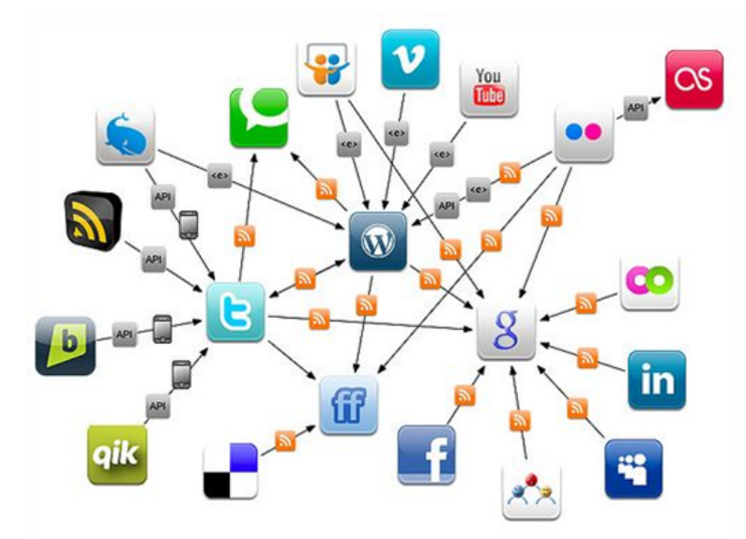
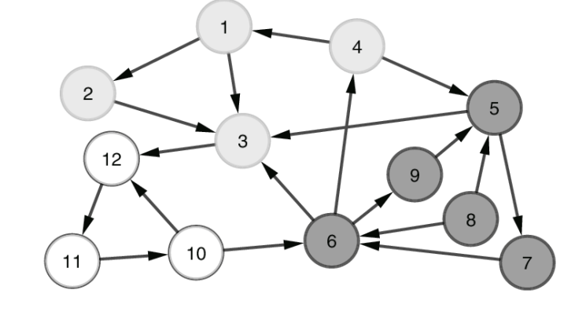
Matrix factorization
Page-rank
How to evaluate the importance and relevance of pages
Slide from Sheng Zhou

Slide 31
Matrix factorization
Basic assumptions of Page-rank:
In a webpage, each hyperlink represents a vote from the source page to the target page.
An important page often receives more votes.
An important page receives vote from other important pages.
Slide from Sheng Zhou

Slide 32
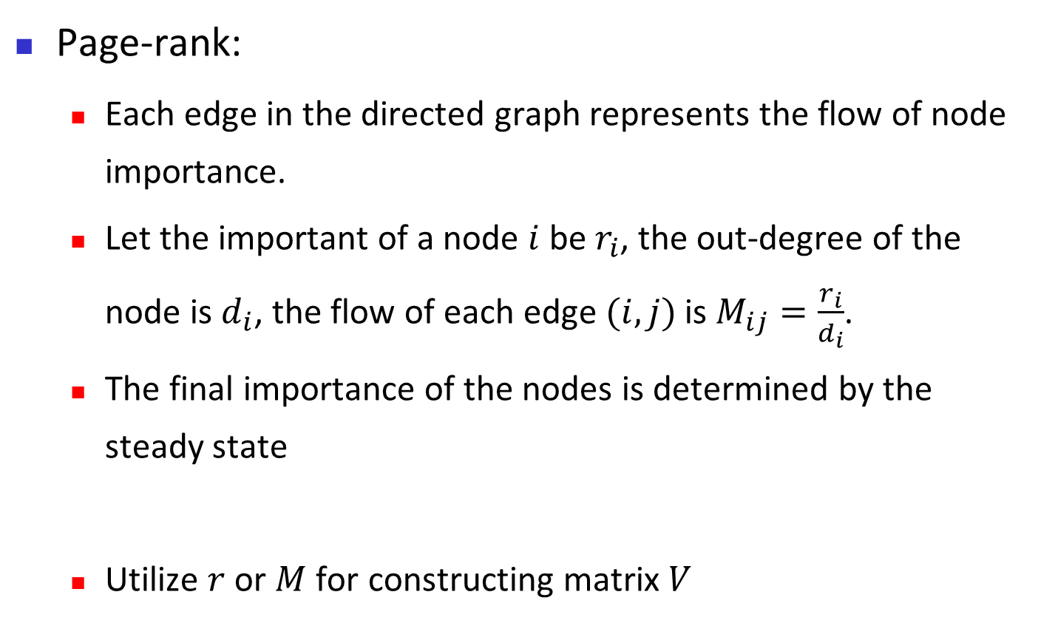
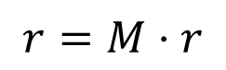
Matrix factorization
Page-rank:
Each edge in the directed graph represents the flow of node importance.
Let the important of a node $i$ be $r_{i}$, the out-degree of the node is $d_{i}$, the flow of each edge $(i,j)$ is $M_{ij}=\frac{r_{i}}{d_{i}}$.
The final importance of the nodes is determined by the steady state
Utilize $r$ or $M$ for constructing matrix $V$
$$r=M⋅r$$
Slide from Sheng Zhou

Slide 33
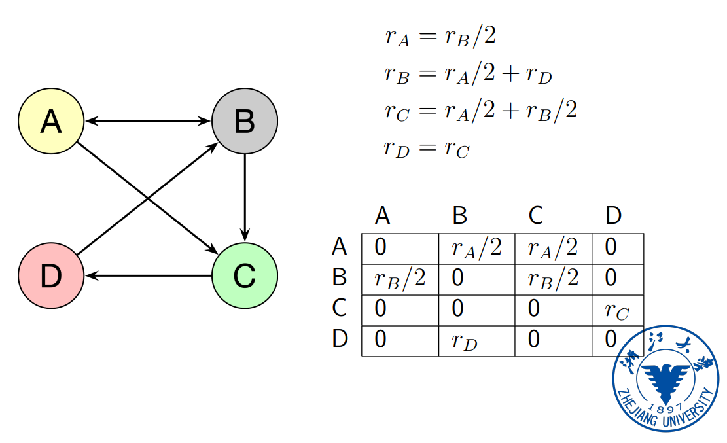
Matrix factorization
Page-rank --- an example:
Slide from Sheng Zhou

Slide 34
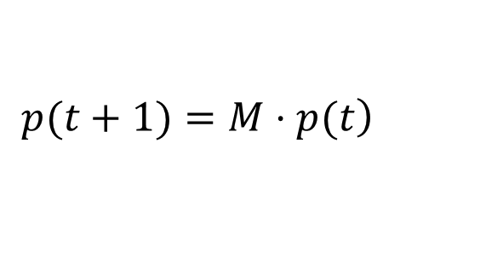
Matrix factorization
Page-rank --- another perspective:
Considering a “Web crawler” with random walker
Locate at i-th node
Randomly choose a hyperlink for walking
Walk from i-th node to another j-th node
Continuously repeat the above processes
The probability of the node that the crawler finally locates at:
$$\left.p(t+1)=M⋅p(t\right)$$
Slide from Sheng Zhou

Slide 35
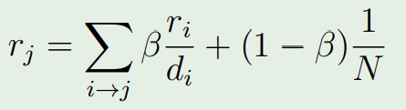
Matrix factorization
Rooted Page-rank:
Weaknesses of page-rank:
Some nodes may have no out-edges
There exists non-connected components in a graph
Rooted Page-rank adds a small probability to randomly walk to an arbitrary node
Slide from Sheng Zhou

Slide 36
Graph Representation Learning
Classic graph representation learning
Matrix factorization
Random walk
Slide from Sheng Zhou
Notes:
机器学习是基础。

Slide 37
Random Walk
Node representation via random walk
Performing random walk on graph to generate multiple sequences of nodes
utilizing node2vec technique to get the node representation
Slide from Sheng Zhou
Notes:
把复杂难搞的图结构信息，转换为序列信息。

Slide 38
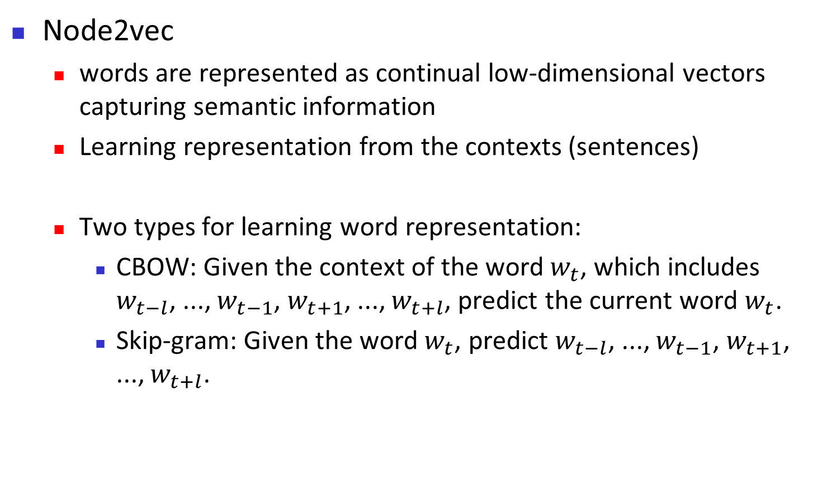
Random Walk
Node2vec
words are represented as continual low-dimensional vectors capturing semantic information
Learning representation from the contexts (sentences)
Two types for learning word representation:
CBOW: Given the context of the word$w_{t}$, which includes $w_{t−l}$, ..., $w_{t−1}$, $w_{t+1}$, ..., $w_{t+l}$, predict the current word $w_{t}$.
Skip-gram: Given the word$w_{t}$, predict $w_{t−l}$, ..., $w_{t−1}$, $w_{t+1}$, ..., $w_{t+l}$.
Slide from Sheng Zhou
Notes:
把复杂难搞的图结构信息，转换为序列信息。

Slide 39
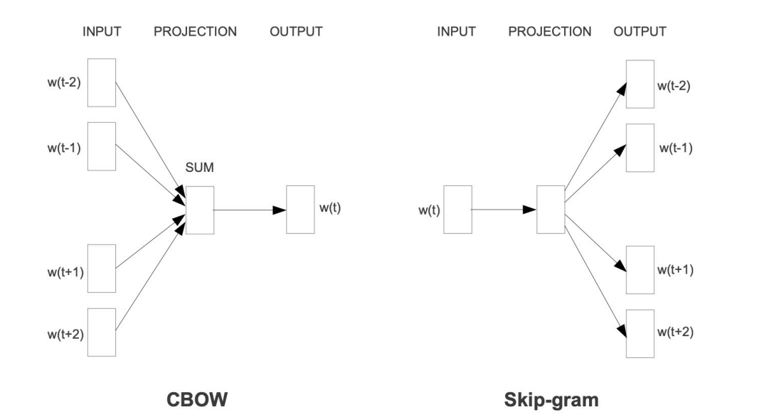
Random Walk
CBOW and Skip-gram:
Slide from Sheng Zhou
Notes:
把复杂难搞的图结构信息，转换为序列信息。

Slide 40
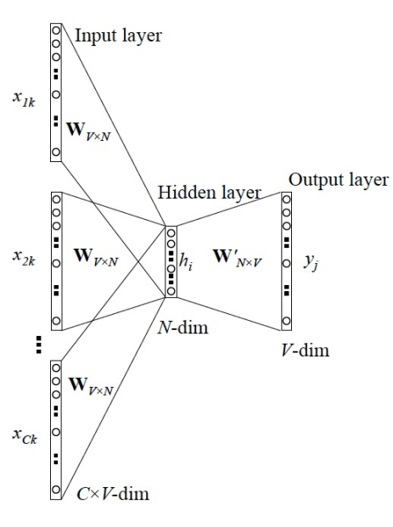
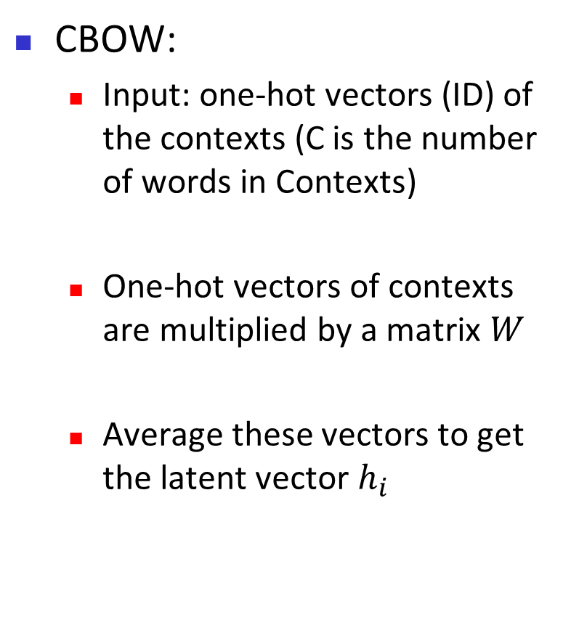
Random Walk
CBOW:
Input: one-hot vectors (ID) of the contexts (C is the number of words in Contexts)
One-hot vectors of contexts are multiplied by a matrix $W$
Average these vectors to get the latent vector $h_{i}$
Slide from Sheng Zhou
Notes:
把复杂难搞的图结构信息，转换为序列信息。

Slide 41
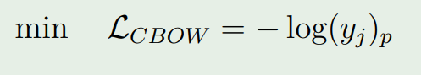
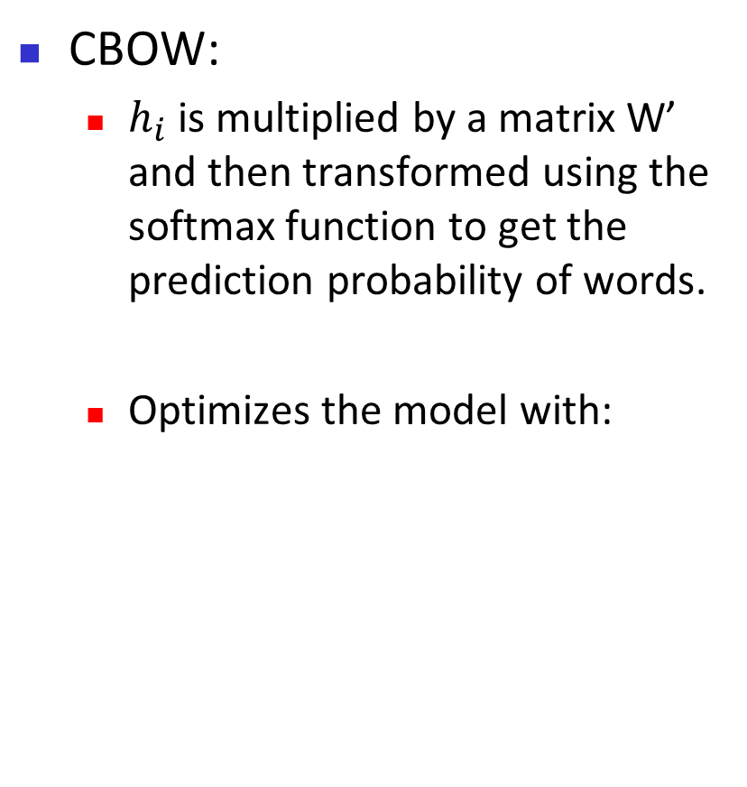
Random Walk
CBOW:
$h_{i}$ is multiplied by a matrix W’ and then transformed using the softmax function to get the prediction probability of words.
Optimizes the model with:
Slide from Sheng Zhou
Notes:
把复杂难搞的图结构信息，转换为序列信息。

Slide 42
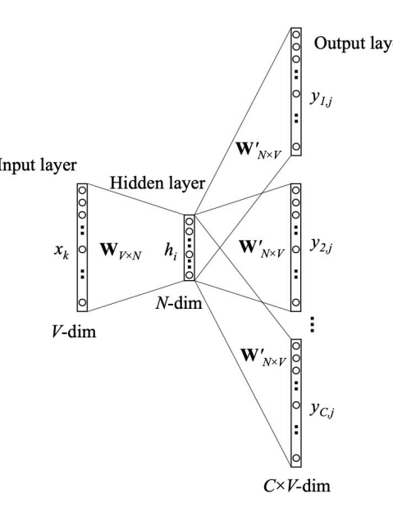
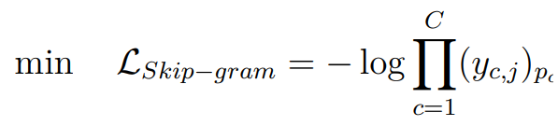
Random Walk
Skip-gram:
Utilize the current word to predict the contexts.
Optimizes the model with:
Slide from Sheng Zhou
Notes:
把复杂难搞的图结构信息，转换为序列信息。

Slide 43
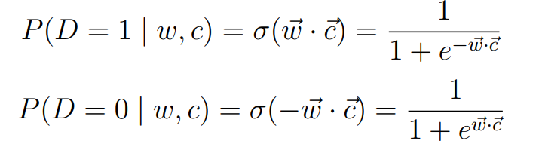
Random Walk
From the perspective of co-occurring words, Skip-gram optimizes:
Due to the large-scale of the space of words, two strategies are proposed for acceleration:
Hierarchical softmax
Negative Sampling
Slide from Sheng Zhou
Notes:
把复杂难搞的图结构信息，转换为序列信息。

Slide 44
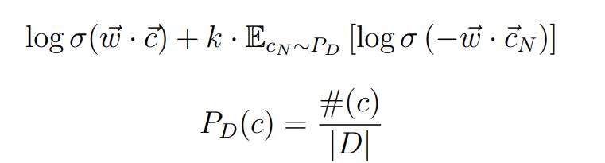
Random Walk
word2vec utilizes skip-gram with negative-sampling:
Slide from Sheng Zhou
Notes:
把复杂难搞的图结构信息，转换为序列信息。

Slide 45
Random Walk
DeepWalk is on the basis of Word2vec with leveraging random walk to generate sequences of nodes
The first deep-learning model on the graph
Capture high-order neighbor relations:
Graph neighbors -> word contexts
Unsupervised learning
Easy parallelization
Fast adaptation
Slide from Sheng Zhou
Notes:
把复杂难搞的图结构信息，转换为序列信息。

Slide 46
Random Walk
Deepwalk:
Performing random walk from each node to generate multiple sequences of nodes
Utilizing word2vec (skip-gram) to learn node representations
Slide from Sheng Zhou
Notes:
把复杂难搞的图结构信息，转换为序列信息。

Slide 47
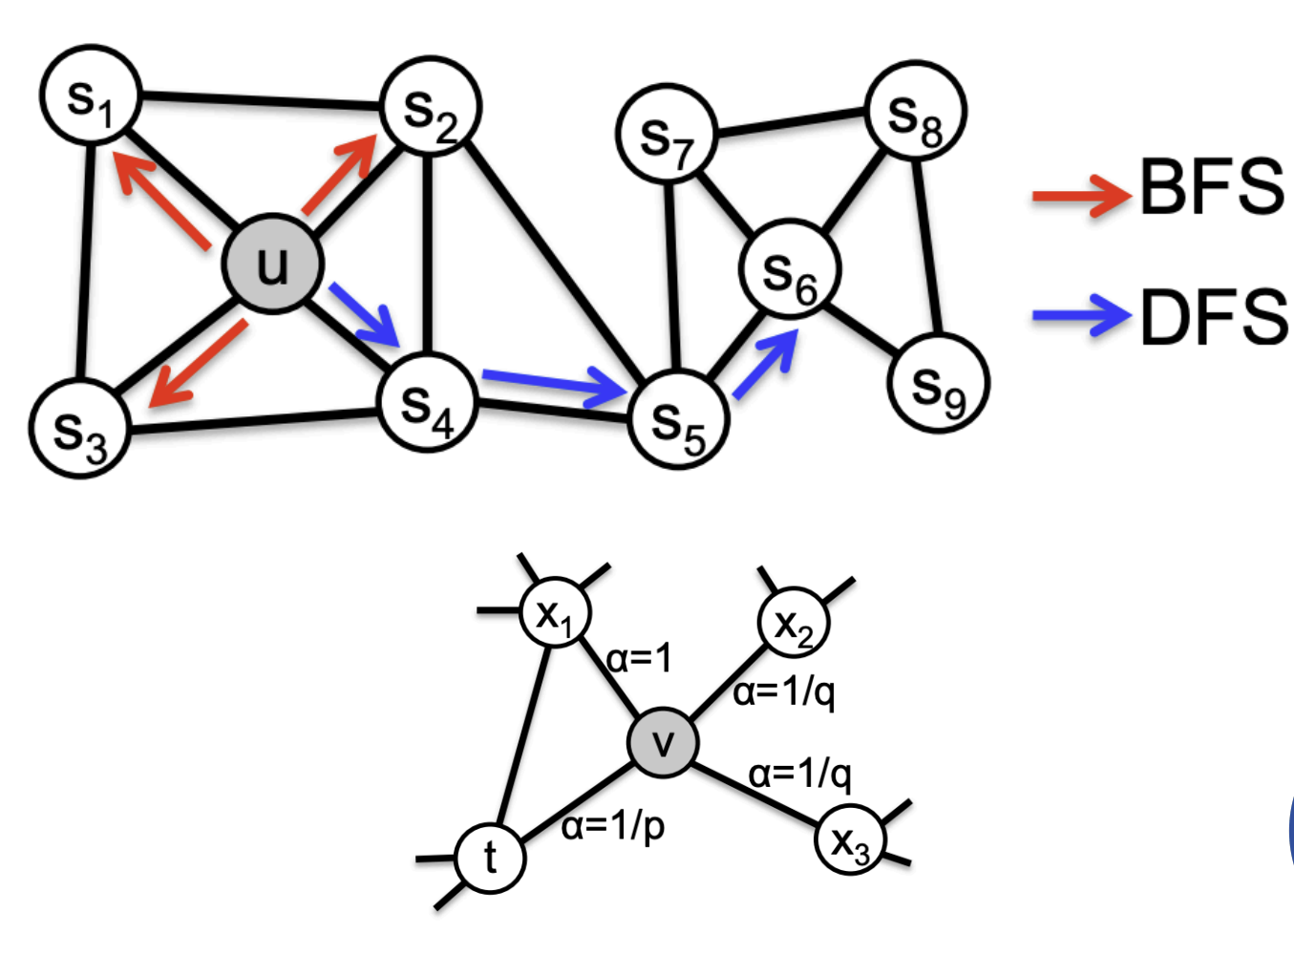
Random Walk
node2vec:
Slide from Sheng Zhou
Notes:
把复杂难搞的图结构信息，转换为序列信息。

